Slide 1
Socket Programming CS F303
Dr. Pranav M. Pawar

Slide 2
Socket
Socket
The combination of an IP address and a port number.
The name of the Berkeley-derived application programming interfaces (APIs) for applications using TCP/IP protocols.
Two types
Stream socket : reliable two-way connected communication streams
Datagram socket
Socket pair
Specified the two end points that uniquely identifies each TCP connection in an internet.
4-tuple: (client IP address, client port number, server IP address, server port number)

Slide 3
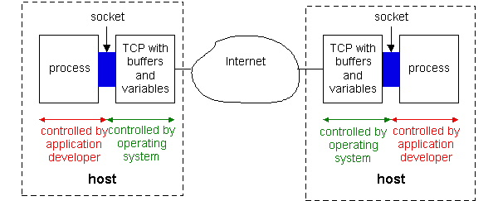
Socket Programming with TCP

Slide 4
Socket for Client and Server
Server
Welcoming socket
Welcomes some initial contact from a client.
Connection socket
Is created at initial contact of client.
New socket that is dedicated to the particular client.
Client
Client socket
Initiate a TCP connection to the server by creating a socket object. (Three-way handshake)
Specify the address of the server process, namely, the IP address of the server and the port number of the process

Slide 5
Socket Function Call
socket (): Create a socket
bind(): bind a socket to a local IP address and port #
listen(): passively waiting for connections
connect(): initiating connection to another socket
accept(): accept a new connection
Write(): write data to a socket
Read(): read data from a socket
sendto(): send a datagram to another UDP socket
recvfrom(): read a datagram from a UDP socket
close(): close a socket (tear down the connection)

Slide 6
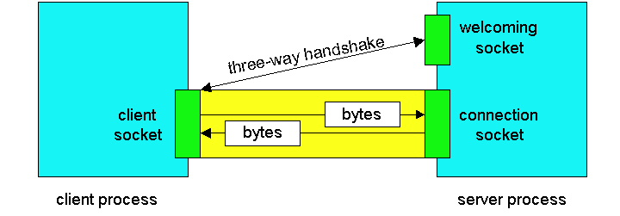
Socket Communication

Slide 7
Socket-programming using TCP
socket( )
bind( )
listen( )
server
client
socket( )
bind( )
connect( )
TCP conn. request
TCP ACK
accept( )
send( )
recv( )
recv( )
close( )
send( )
close( )
controlled by
application
developer
process
process
socket
controlled by
operating
system
TCP with
buffers,
variables
socket
TCP with
buffers,
variables
internet

Slide 8
Socket programming with TCP
Example client-server app:
client reads line from standard input (inFromUser stream) , sends to server via socket (outToServer stream)
server reads line from socket
server converts line to uppercase, sends back to client
client reads, prints modified line from socket (inFromServer stream)
Client
process
Input stream:
sequence of bytes
into process
output stream:
sequence of bytes
out of process
client TCP socket

Slide 9
Client/server socket interaction: TCP
Server (running on hostid)
Client
create socket,
port=x, for
incoming request:
welcomeSocket =
ServerSocket()
TCP
connection setup
create socket,
connect to hostid, port=x
wait for incoming
connection request
connectionSocket =
welcomeSocket.accept()
clientSocket =
Socket()
send request using
clientSocket
read request from
connectionSocket
write reply to
connectionSocket
read reply from
clientSocket
close
connectionSocket
close
clientSocket

Slide 10
JAVA TCP Sockets
In Package java.net
java.net.Socket
Implements client sockets (also called just “sockets”).
An endpoint for communication between two machines.
Constructor and Methods
Socket(String host, int port): Creates a stream socket and connects it to the specified port number on the named host.
InputStream getInputStream()
OutputStream getOutputStream()
close()
java.net.ServerSocket
Implements server sockets.
Waits for requests to come in over the network.
Performs some operation based on the request.
Constructor and Methods
ServerSocket(int port)
Socket Accept(): Listens for a connection to be made to this socket and accepts it. This method blocks until a connection is made.

Slide 11
Problem Statement
Develop a multithreaded TCP server and verify the same.
Develop a java based Echo TCP server and verify the same using a telnet client.

Slide 12
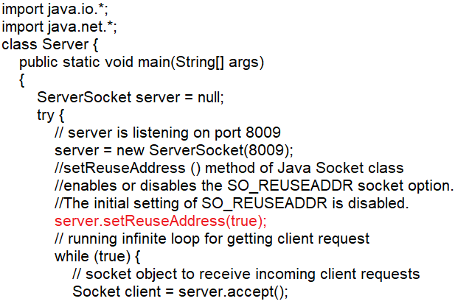
Multithreaded TCP server (1)
Step 1: Write Multithreaded TCP server program using Socket programming.
Create Server.java file and write following code in it.

Slide 13
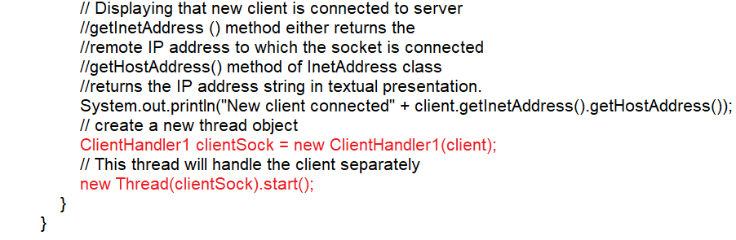
Multithreaded TCP server (2)

Slide 14
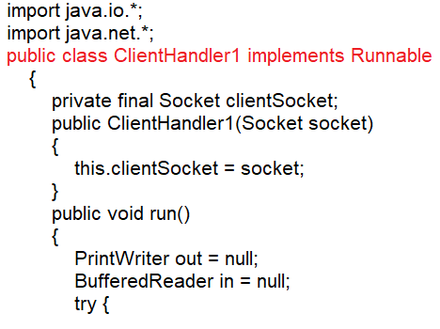
Multithreaded TCP server (3)
Step 2: Create ClientHandler.java for handling multiple clients.

Slide 15
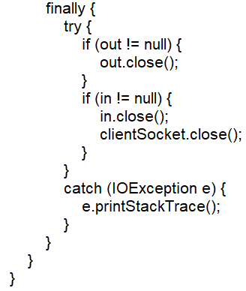
Multithreaded TCP server (5)

Slide 16
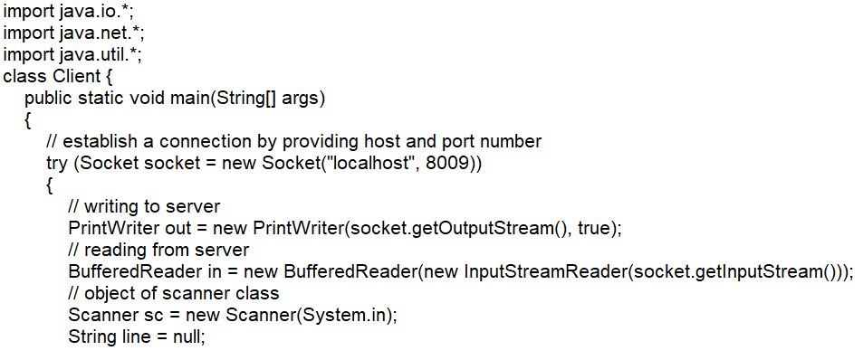
TCP client (1)
Step 3: Create Client.java

Slide 17
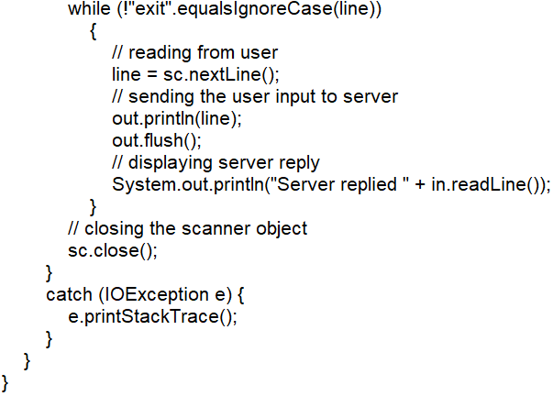
TCP client (2)

Slide 18
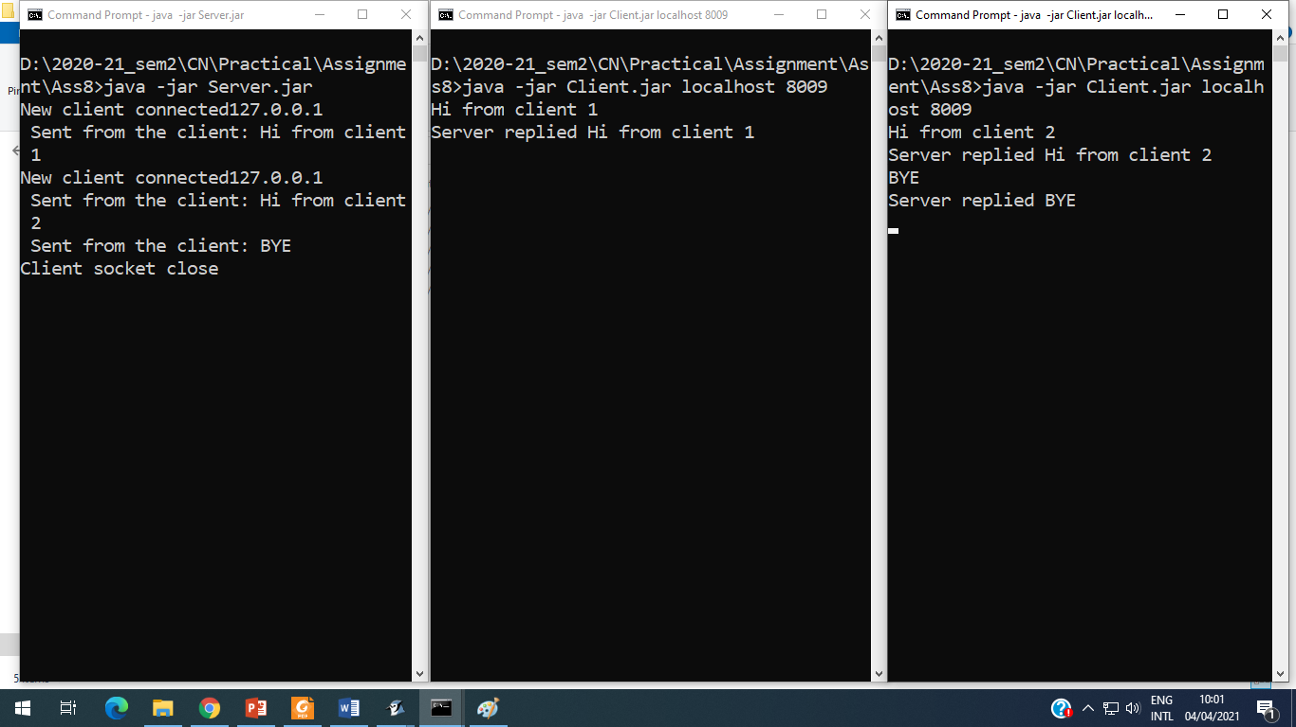
Execute Multithreaded Server and Clients
Step 4: Run the server and connect multiple clients to it.

Slide 19
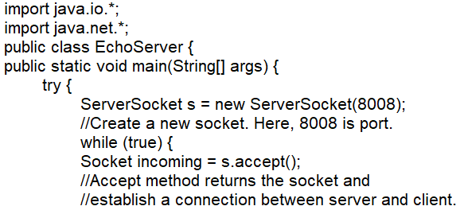
Echo TCP Server (1)
Step 1: Write Echo TCP Server program using Socket programming.
Create EchoServer.java file and write following code in it.

Slide 20
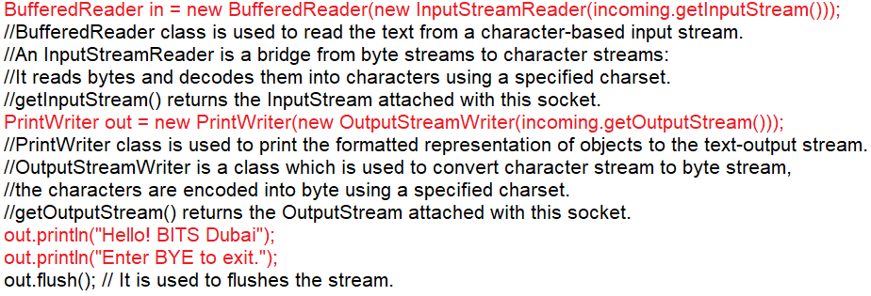
Echo TCP Server (2)

Slide 21
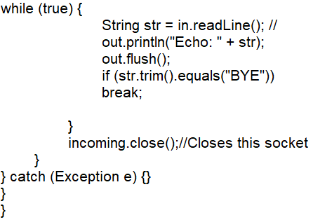
Echo TCP Server (3)

Slide 22
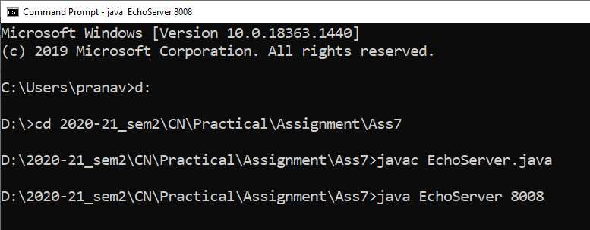
Execute the server
Step 2: Run the server inside command prompt

Slide 23
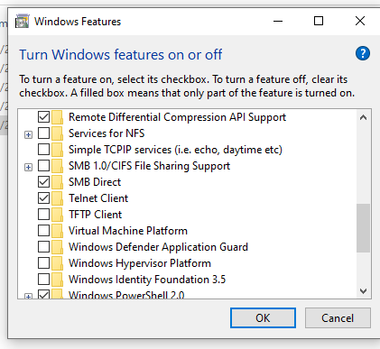
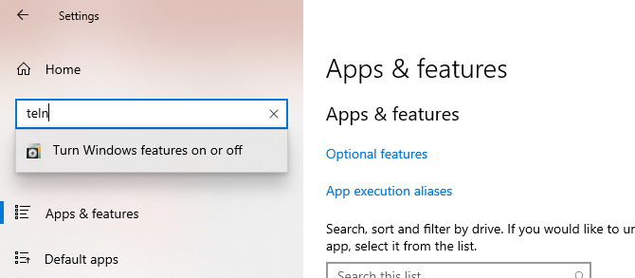
Run Telnet Client (1)
Step 3: Turn on Telnet Client Service from Windows Settings.
Search for “Turn Windows features on or off” in search tool bar in windows setting and turn on Telnet Clinet for list windows features

Slide 24
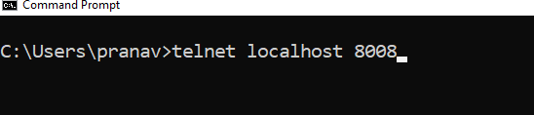
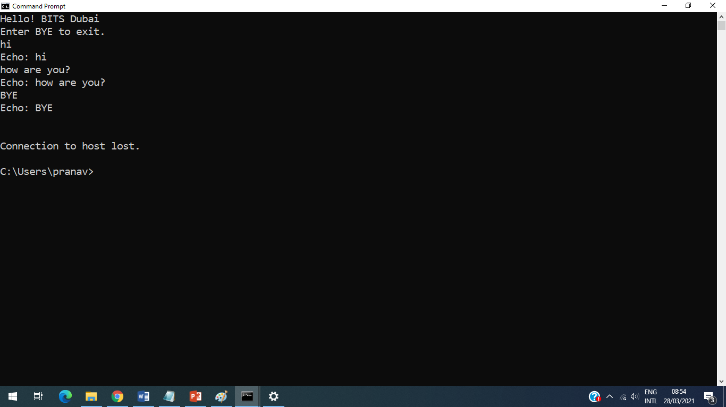
Run Telnet Client (2)

Slide 25
Practice Statement
Develop a multi-threaded TCP server which perform following operations requested by clients and replying outcome of each operation to requested client,
Addition, Subtraction, Division and Multiplication.
Conversion of string send from client into capital letters.
Develop a Echo TCP server, who echo string enter by client in capital letters and verify the same using a telnet client.
Develop a Echo TCP server, who echo string enter by client in capital letters and verify it by developing your own Echo TCP client.

Slide 26
Sources
https://www.codejava.net/java-se/networking/java-socket-server-examples-tcp-ip
https://www.javatpoint.com/socket-programming
https://www.tutorialspoint.com/java/java_networking.htm#:~:text=Sockets%20provide%20the%20communication%20mechanism,its%20end%20of%20the%20communication.
https://www.it.uu.se/edu/course/homepage/distrinfo/ht11/schedule/Java_Socket_Programming.ppt

Slide 27
Thank You!

